Slide 1
Bathroom Renovation
Project presentation

Slide 2
Introduction
The foremost objective is to make over an archaic master bathroom a more spacious and appealing one.
Dimensions were accurately taken to make sure the products apt into place as planned.
Modifications for gaining storage space and improved lighting were prioritized to make sure that the refurbished bathroom stands the test of time.

Slide 3
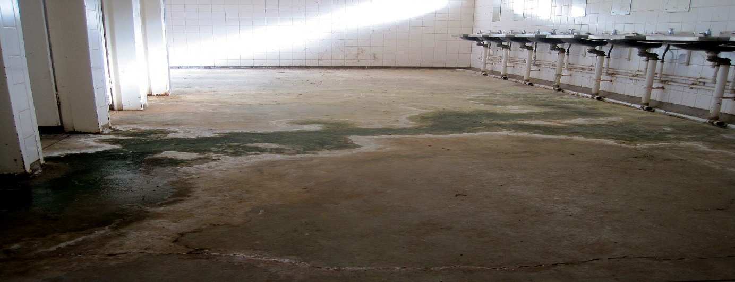
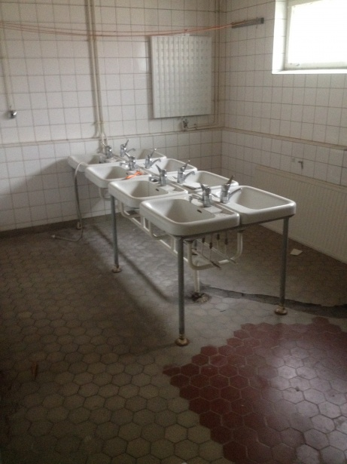
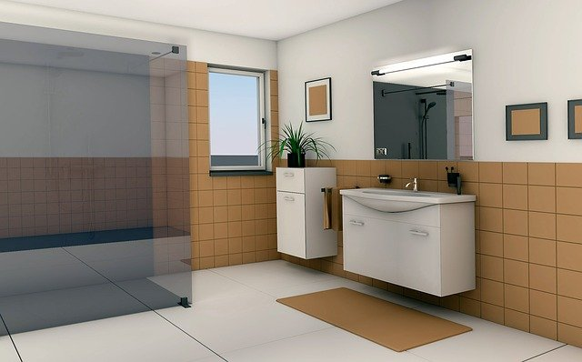
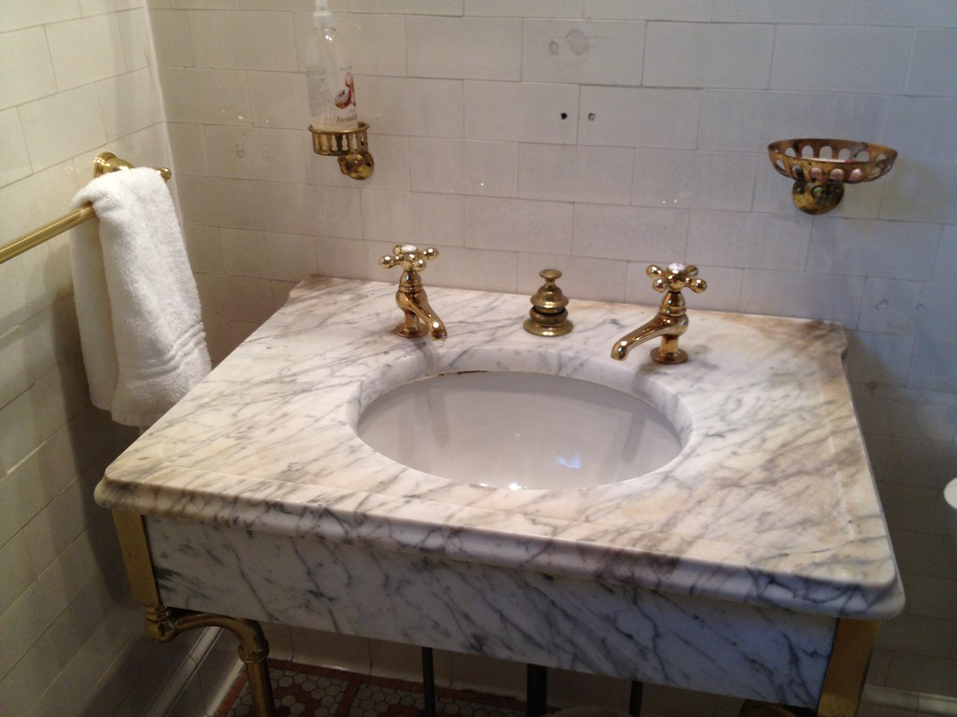
Bathroom Photos

Slide 4
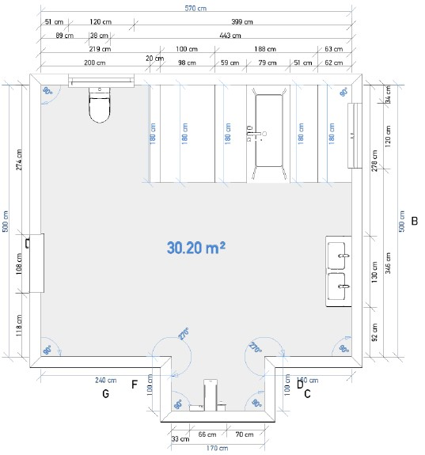
Electronic Design (before)
Wall thickness: 35cm
Room height: 300cm
Floor dimensions: 150cm by 230cm
Shower area dimensions: 600cm by 520cm
Products selected
Shower panel 1650 by 800 by 620mm
Wash-down toilet 400 by 500mm
Bath 2000 by 1000mm
Double vanity washbasin 1500 by 560mm

Slide 5
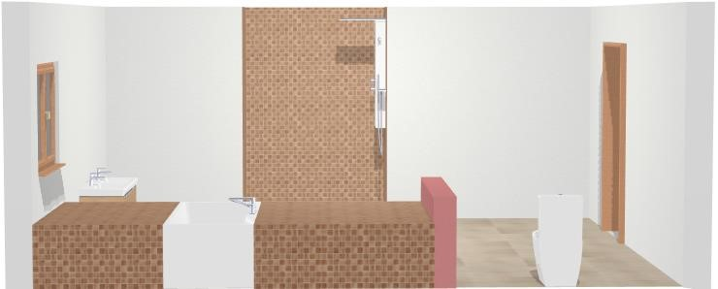
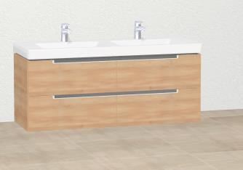
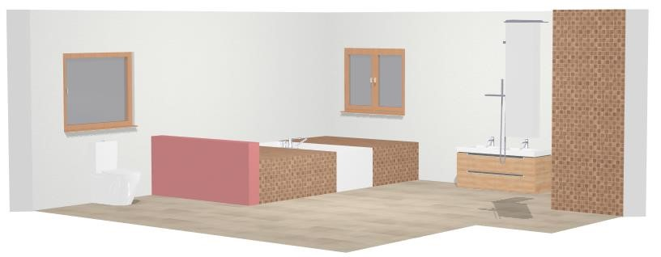
Digital model (existing bathroom)

Slide 6
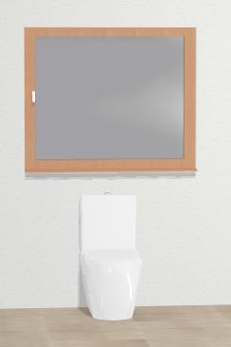
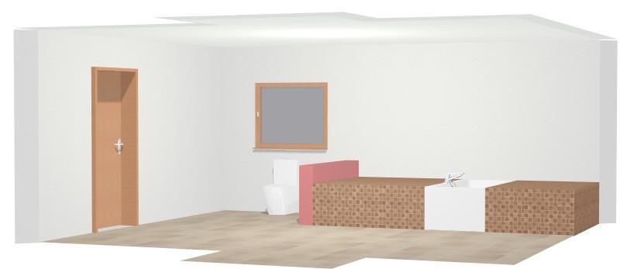
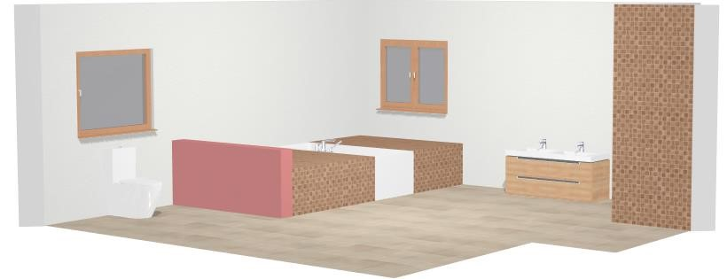
Digital model (existing bathroom)

Slide 7
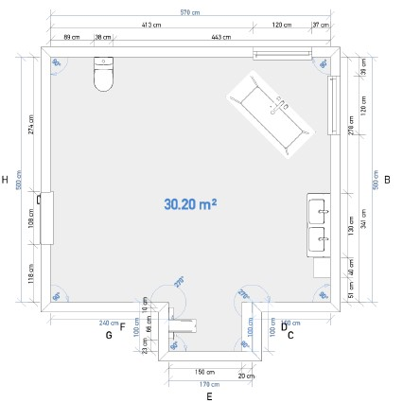
Electronic design( proposed Model)
The fixtures in this bathroom facelift were not changed.
Bathroom backsplashes were fitted to prevent water from ruining the walls as well as giving it a new look.
Tall cabinet with dimensions 500 by 1600 by 400 mm was installed which increased storage space.
Front wall near the toilet was removed to give the additional space.
Bath was repositioned to make use of the available space.
Window repositioned to allow more light to enter the bathroom.

Slide 8
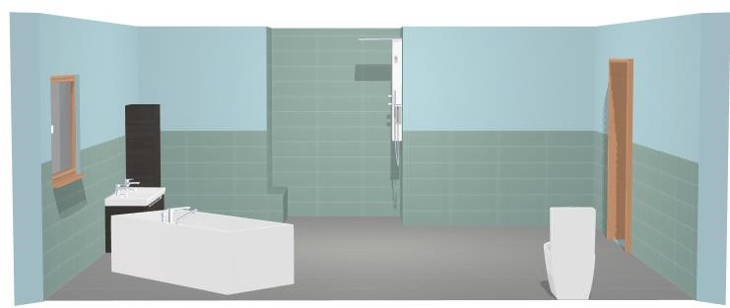
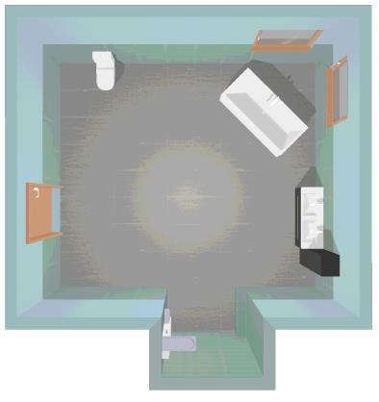
Digital model(proposed bathroom)
Proposed model

Slide 9
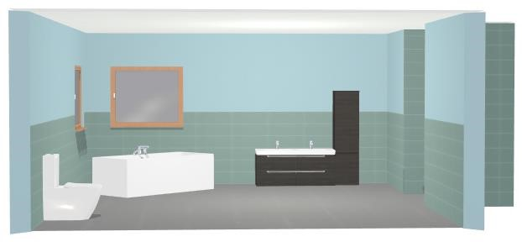
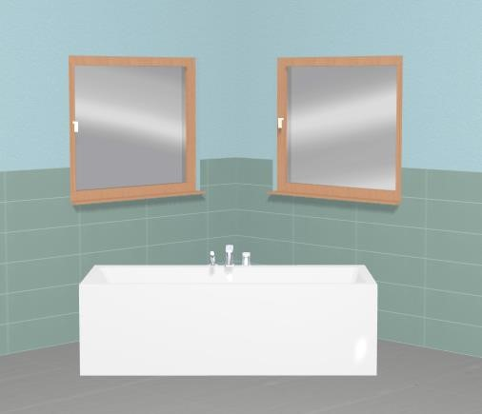
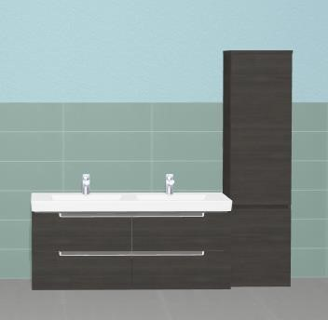
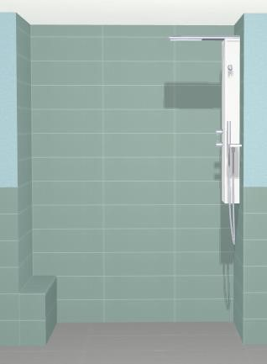
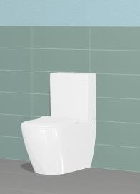
Proposed model

Slide 10
calculations
The surface area of the floor= (600cm X 520cm) + (150cm X 230cm)
= 34.6m2
Window area= (150cm X 230cm)
= 3. 45m2
Door area = (100cm X 150cm)
=1.5m2
Surface area of the walls excluding shower area: room height 300cm. SA= (400cm X 300cm) + (600cm X 300cm) + (200cm X 300cm) + (100cm X 300cm)
= 39m2
39m2-Window area - door area
= 39 – 3.45 – 1.5 = 34.05m2

Slide 11
Calculations
Backsplash tiles around the walls excluding shower area: tiles lifted at a height of 150cm. SA of the back splash tile = ( 600 X 150) + ( 520 X 150) + ( 400 X 150) + ( 250 X 150) + ( 300 X 150) = (560 X 150)
= 30.85m2
Surface area of the floor = 30. 85m2
Shower area floor = 200cm X 150
= 3m2

Slide 12
Conclusion
The renovated bathroom with the backsplash tiles and the removal of unnecessary walls gave it a new look. The repositioning of the windows and bath allowed for better performance in terms of lighting and spaciousness for storage.

